Slide 1



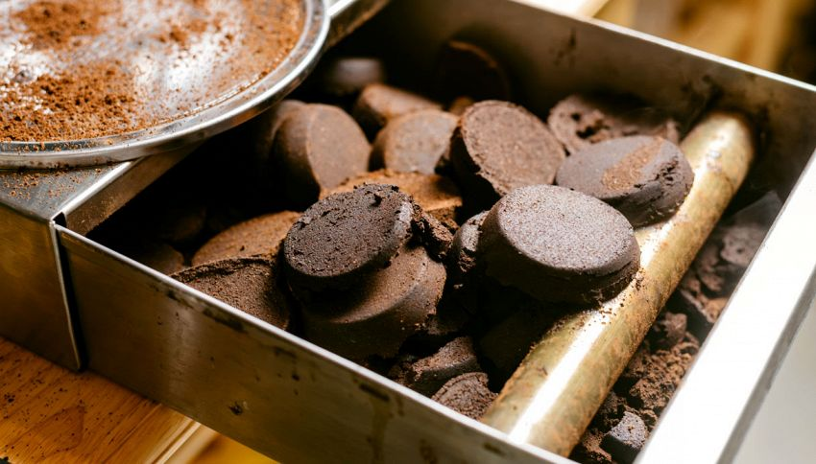
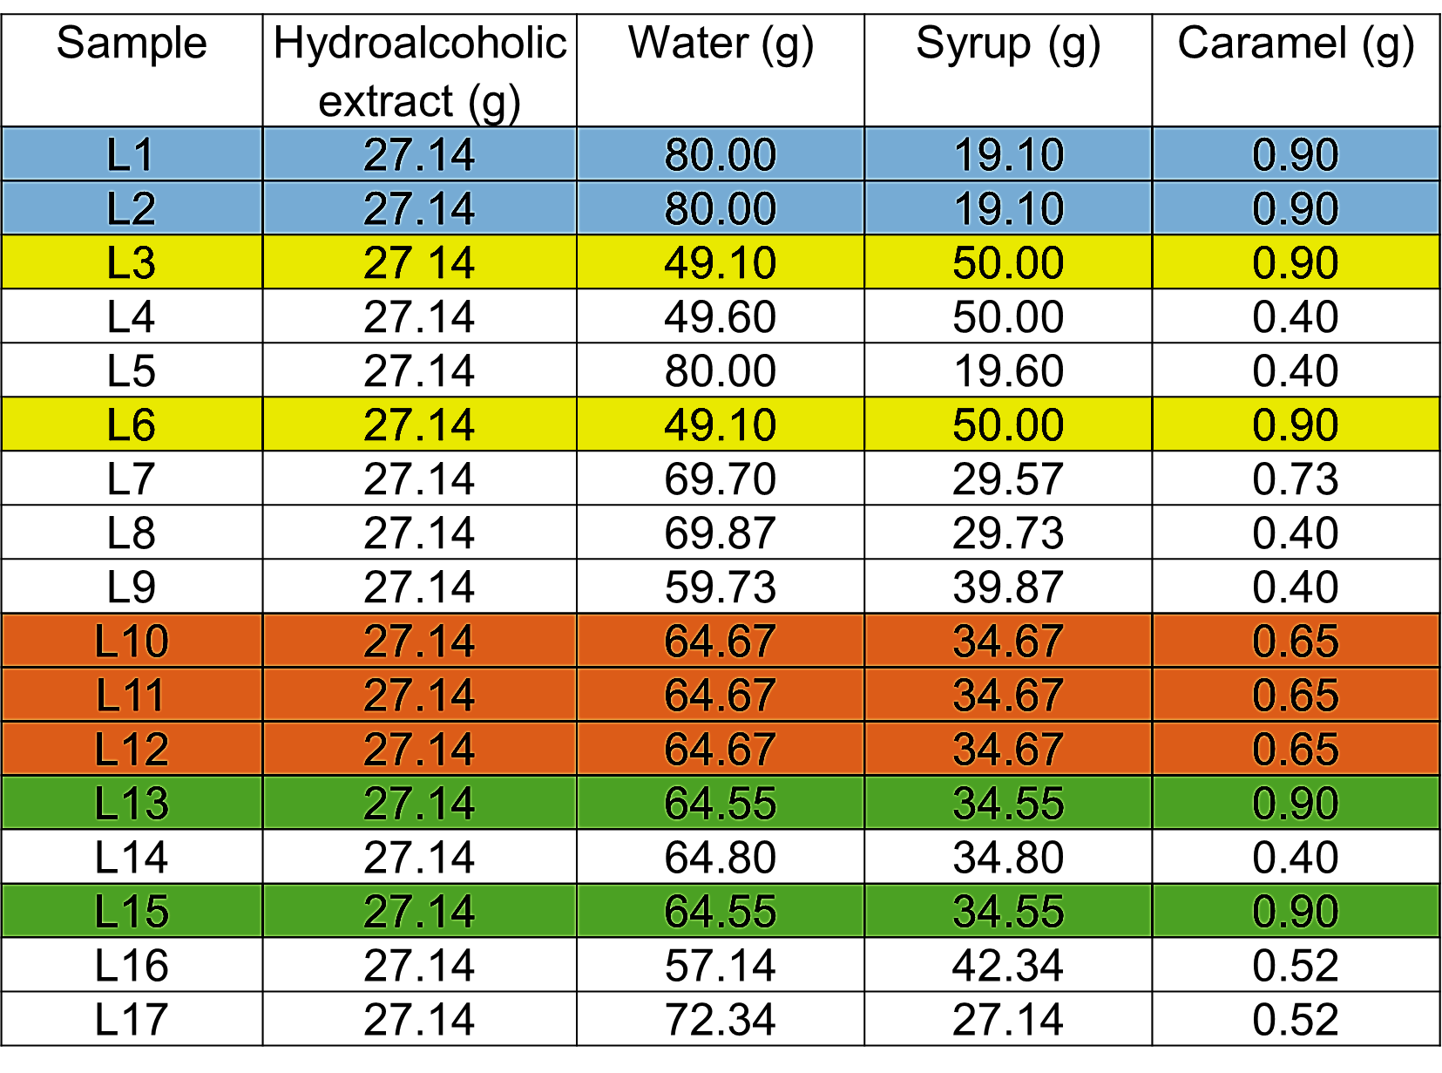
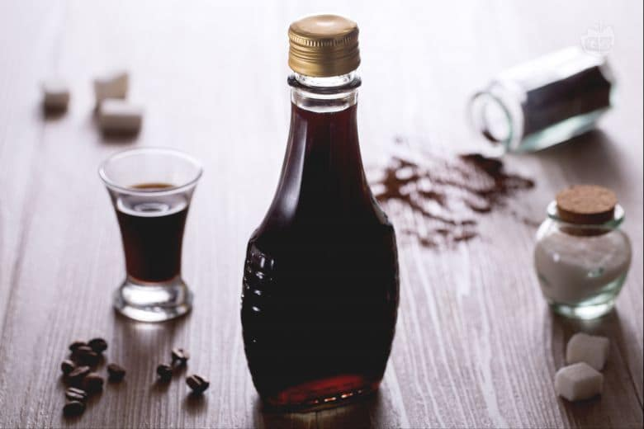

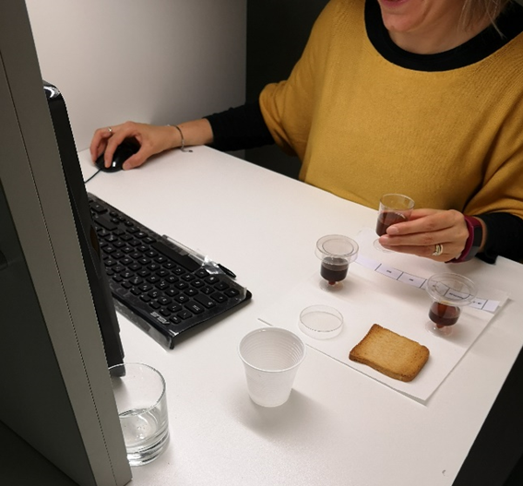
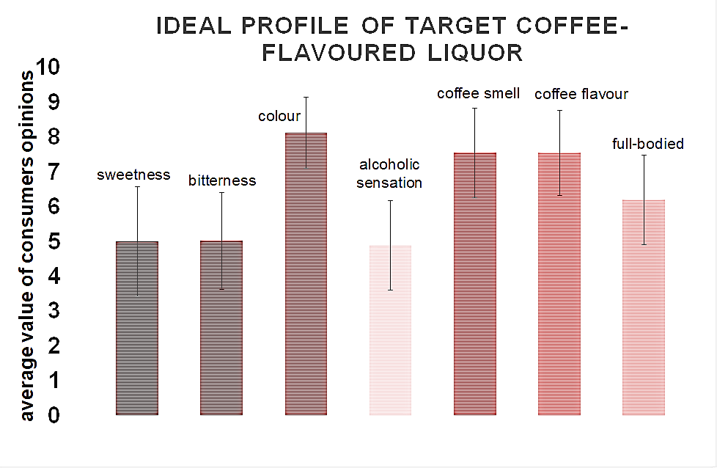
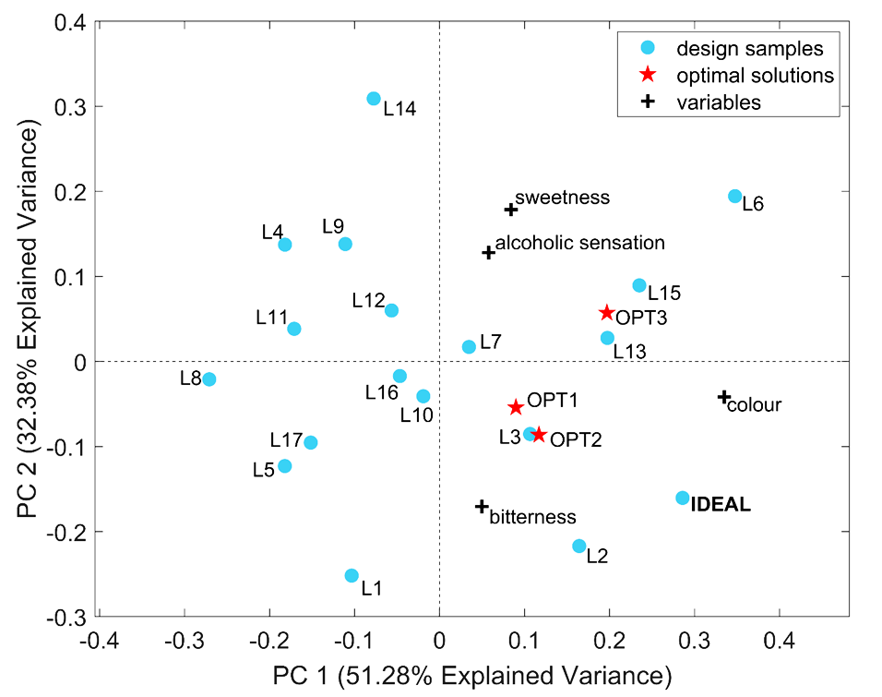
Sustainable innovation: sensory study of coffee-flavoured liqueur from spent coffee grounds
Francesca Masino^{1,2}, Giuseppe Montevecchi^{1,2}, Rosalba Calvini², Giorgia Foca^{1,2}, Andrea Antonelli^{1,2}
¹ BIOGEST - SITEIA Interdepartmental Centre, University of Modena and Reggio Emilia, Piazzale Europa 1, 42124 Reggio Emilia, Italy.
² Department of Life Sciences, University of Modena and Reggio Emilia, Via G. Amendola 2 (Pad. Besta), 42122 Reggio Emilia, Italy.
E-mail address: francesca.masino@unimore.it; giuseppe.montevecchi@unimore.it
INTRODUCTION
Spent coffee grounds (SCG) are the main residue of the coffee industry. They are a source of sugars, proteins, lipids, polysaccharides with immunostimulatory activity, biopolymers (lignin, cellulose, and hemicelluloses), and bioactive compounds (caffeine with psychoactive effects, trigonelline, and phenolics with antioxidant activity) (Silva et al., 1998; Yen et al., 2005). In addition, a considerable amount of volatiles is still present. For all these reasons, the valorisation of this by-product is a relevant aim of food industries. The most common applications are linked to the production of biodiesel through the transesterification of fat into fatty acid methyl esters.
Chemical water removal though absolute ethanol extraction is a convenient alternative to energivorous heat drying. Furthermore, the hydroalcoholic extract is a promising raw material that possesses an agreeable coffee scent that could conveniently be used as a basis for a coffee liquor.
AIM
The study is aimed at assessing the suitability of the hydroalcoholic fraction extracted from SCG to formulate a coffee-flavoured liqueur with a sensory profile capable of meeting consumers’ expectations.
MATERIALS AND METHODS
  Samples of the coffee-flavoured liqueurs
SCG
Water and volatiles extraction using abs. ethanol → Hydroalcoholic extract
Fat extraction through hexane
Defatted and dried SCG
Coffee-flavoured liqueurs
Based on a mixture experimental design, a total of 17 coffee-flavoured liqueurs, including replicates, were obtained at a lab-scale by adding variable amounts of water, glucose syrup, and caramel (E150 A) to a fixed quantity of hydroalcoholic extract flavoured with vanillin (0.1% w/w) in order to reach 21.10% alcohol by volume.
Intended for
various applications
  2. Selection of sensory attributes
  Colour
  Coffee smell and flavour
  Body, alcoholic sensation
  Bitterness
  Sweetness
  3. Market survey
  328 consumers were asked to answer a questionnaire about the intensity of attributes of the coffee liqueur using a “Numerical Rating Scale” from 1 (low) to 10 (high).
4. Sensory evaluation
A descriptive sensory evaluation was conducted by 17 trained judges through a randomized incomplete block procedure. In each session, every sample was tasted 3 times by different judges for a total of 6 evaluations.
RESULTS
1. Frequency of attribute citation (FC%)
A set of 7 attributes out of 14 was selected through the FC% expressed by all judges. Only the attributes with an FC% higher than 80% (i.e., sweetness, bitterness, colour, alcoholic sensation, coffee smell and flavour, and full-bodied) were selected for the subsequently statistical experiments.
  2. The IDEAL PROFILE of the target coffee liqueur based on the market survey was defined as the average value of consumers’ opinions.
3. Modelling
The processing of the experimental design results led to define a model for each sensory variable in order to correlate panellists’ scores with the considered
 | Colour | Alcoholic sensation | Bitterness | Sweetness | A: WATER (% w/w) | B: GLUCOSE SYRUP (% w/w) | C: CARAMEL (% w/w)
OPT1 | 6.09 | 6.70 | 5.47 | 5.00 | 69.15 | 29.95 | 0.90
OPT2 | 6.33 | 6.64 | 5.66 | 4.87 | 53.80 | 45.30 | 0.90
OPT3 | 6.78 | 7.02 | 5.02 | 5.91 | 50.77 | 48.33 | 0.90
factors (i.e. the 3 ingredients of the mixture). Before accepting each model, it was verified that the theoretical assumptions for a multiple linear regression model were respected (normal distribution of the errors and constant error variance for any value of the independent variables). As for the optimisation process, we considered only the significant models (i.e. colour, alcoholic sensation, bitterness, and sweetness) and the desirability function was calculated using the weighted performance of each significant model. The target for optimisation is given by the values of these 4 variables as they were hypothesized for the ideal liquor based on the market survey. Among all the calculated combinations, only 3 of them were close to the target and so they were considered OPTIMAL SOLUTIONS (OPT).
4. Principal Component Analysis (PCA) performed using panel test results of the 4 significant variables allowed to outline 3 coffee-flavoured liqueurs with a sensory profile close to OPTs as well as to the IDEAL ONE. Samples L3, L13, and L15 showed a deep black colour due to the higher quantity of caramel. In addition, the judges evaluated these samples as more balanced than the others in terms of alcohol strength, bitterness, and sweetness.
REFERENCES
Silva et al., 1998. Biomass and Bioenergy, 14, 457-467. Yen et al., 2005. Journal of Agricultural and Food Chemistry, 53, 2658-2663

