Slide 1
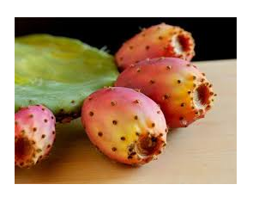

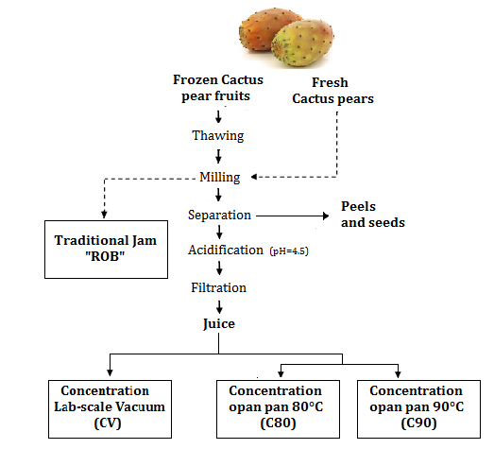
Changes in quality parameters, Proline, Betalains and Color during different thermal processes of Cactus pear (Opuntia ficus indica) juices
S. Bouazizi ¹, G. Montevecchi ², F. Masino ², M. Hamdi ¹
Centro
di Ricerca Interdipartimentale
BIOGEST-SITEIA
¹ Laboratory of Ecology and Microbial Technology (LETMi). INSAT. Carthage University.
² Dipartimento di Scienze Agrarie e degli Alimenti, Università degli Studi di Modena e Reggio Emilia, Italy.
Introduction
II- Chemical characterization of concentrates products
Results shows that fresh prickly pear juice was initially rich in glucose, fructose and proline fulfilling the prerequisites for non-enzymatic browning during processing.
Opuntia ficus indica fruit is an expanded plant grown in Tunisia. This plant represent an untapped potential at industrial level. In view of this, the production of concentrated prickly pear juices is the best way to benefit from it’s high biological activity. This process allow the inclusion of this fruit In novel health promoting food products.
➔This study aimed to investigate the effect of different thermal process concentration on some physical parameters of juice and biochemical compounds retention as Proline, betalains, betaxanthins and HMF.
Table 2: Selected quality parameters of Opuntia concentrated products
Process | Glucose (mg/g) | Fructose (mg/g) | Proline (mg/g) | HMF (mg/g) | Total Betalains content (mg/g)
Initial juice | 77.8 | 69.3 | 1401.3 | 0 | 44.16
CV | 186.7 | 163.6 | 3462.8 | 0 | 43.21
C90 | 146.3 | 124.2 | 2653.3 | 20.6 | 28.52
C80 | 149.5 | 127.8 | 2703.6 | 14.3 | 31.42
ROB | 138.2 | 109.4 | 2032.1 | 46.2 | 21.87
Hot Temperature
Moisture evaporation
Time exposition
Maillard reactions
Sugar-amino acids
Betalains contents
Pigment decline colour parameters browning indices and HMF
Table 2 indicate the increase of glucose, fructose and proline concentration with thermal processes.
Unexpectedly no HMF formation were found after concentration by rotary evaporation.
Methodology
III- Pigments content, colour parameters and browning index of concentrate products
Fresh fruits Opuntia ficus india growing in Zelfen Region (Gassrine) were used. The pulp was ground by automatic juice extractor.
Juice Concentration : Different heating process were employed
The resulting products were characterized in terms of:
Betaxanthin (Bx) and betacyanin (Bc) contents, Bx/Bc ratios as well proline/Bx ratios were determined (Table 3)
Table 3: Pigment compounds of cactus concentrate products and Proline intraction
Process | Total betalain content * | Betaxanthin content (Bx) | Betacyanin content (Bc) | Bx/Bc | Proline/Bx
Initial juice | 44.16 | 35.32 | 8.84 | 3.99 | 39.67
CV | 43.21 | 35.12 | 8.09 | 4.34 | 98.59
C90 | 28.52 | 22.92 | 5.60 | 4.09 | 115.76
C80 | 31.42 | 26.52 | 4.90 | 5.41 | 101.94
ROB | 21.87 | 17.90 | 5.97 | 4.50 | 113.52
Non-enzymatic Browning index was determined using spectrophotometer: Absorbance at 420nm.
Colour mesurement using a Hunter Lab chroma meter CR-400: L*, C*, h° and delta E.
➔During concentration at laboratory scale virtually a slight changes for Bx or Bc contents and Bx/Bc ratios were observed. However, proline/Bx ratios increased indicating proline-betaxanthin decay.
Glucose, Fructose and HMF determination by HPLC Methods
Betalains contents determination by Spectrophotometric Assay: Absorbance at λ= 538 nm and λ= 480 nm
Proline quantification by HPLC Methods
Results & Discussions
Figure 1: Lightness (L*), chroma (C*), hue angle (h°), total colour difference ΔE* and Browing Index BI monitored after each processing step
➔All concentration processes decreased the color parameters (L, a and b values) in comparison with the initial juice and the products turned reddish brown for the open pan concentration except the vacuum concentration.
➔The most sever color loss was in Traditional Jam (the highest BI) due to the long time and high temperature. However, browning of concentrated juice samples was negligible even after which was attributed to the predominance of proline exhibiting.
I- Mains Characteristics of concentrated juice products
Juice concentrate were produced under room temperature at laboratory scale using a rotary evaporator and open pan evaporator system applying magnetic stirrer with temperature sensor. Traditional jam was purshased from artisan factory (Zelfene).
Table 1: Product yields and physical characteristics of concentrated cactus fruit juice products
Product | Mass prior to concentration (g) | Mass after concentration (g) | Concentration yield (g/g) | TSS (°Brix)
Initial juice | 560 | - | - | 14.4 ±0.01
CV | 560 | 183.68 | 32.8 | 35 ± 0.06
C90 | 560 | 161.84 | 28.9 | 35 ± 0.12
C80 | 560 | 169.34 | 30.24 | 35 ± 0.12
ROB | - | - | 28 | 35 ± 0.01
Conclusions
Despite high amounts of reducing sugars and amino acids, only minor Maillard browning effects were found both for concentrates produced by vacuum evaporation at Lab-scale and open pan system. In particular, basically advanced Maillard reaction products detectable at 420 nm were only observed in conventional concentrate products at 90°C and traditional Jam. Moreover, acceptable overall pigment and proline retention proved the viability for industrial cactus pear juice processing.
Throughout the concentration yields in Table 1, an important decay of weight is observed (arround 70% w/w) due to the highest moisture content of this fruit (90.66 %) .
the vacuum evaporation seems to be the gainful process.

