Slide 1
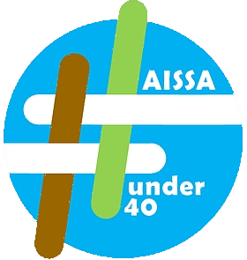
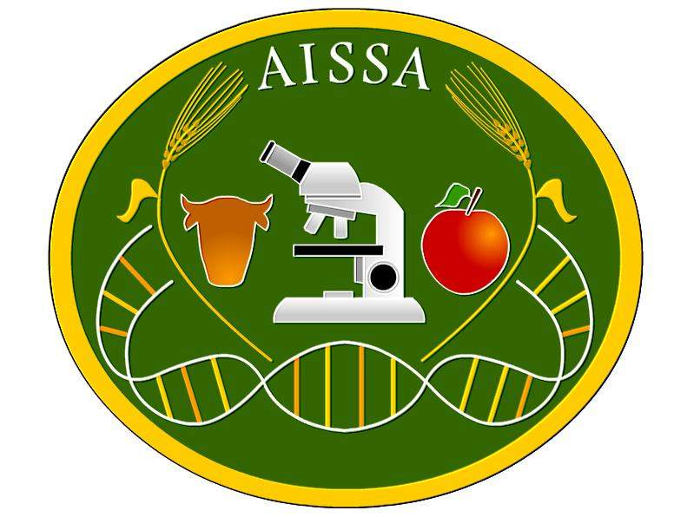
III Convegno AISSA#under40
Bolzano, 14-15 luglio 2022
Facoltà di Scienze e Tecnologie- Libera Università di Bolzano
Effect of foliar fertlizers from fish by-product on growth and development of Lettuce (L. sativa)in green-house conditions
Ben Hassine M. ¹, Caradonia F. ¹, Milc J.A. ¹, Caccialupi G. ¹, Masino F. ¹, Pulvirenti A. ¹, Francia E. ¹, Antonelli A. ¹
¹ Dipartimento di Scienze della vita, Centro BIOGEST-SITEIA, Università di Modena e Reggio Emilia, Via Amendola 2, 42122 Reggio Emilia
Introduction
In Liguria Region, as in all coastal areas, fish represents a relevant part of human diet due to its high-quality protein content, low fat content, and importance as a source of vitamins and minerals (Prato and Biandolino, 2015). Therefore, in the contest of circular economy, the huge quantity of fish by-product produced could be a resource instead of an environmental issue, thus producing materials with high added value. Such an example are fertilizers or biostimulants obtained from fish by-product that can be used to increase the sustainability of crops cultivation. Under the frame of project “FISH – Fertilizzante Innovativo Suolo e Habitat” (PSR Regione Liguria 2014 – 2020 Misura 16), the effect of foliar fertilizers obtained from fish by-product were evaluated on the growth and development of lettuce (Lactuca sativa L. ‘Summerbel’) in green-house conditions.
Materials and Methods
Two consecutive experiments were carried out applying seven different treatments at the 22nd, 29th and 35th day after sowing. Tap water and a commercial product (FISH-MIX®, Biobizz) were compared to two different hydrolyzed products (H and FISH n° 13), a basified-hydrolyzed product (BH), a hydrolyzed-fermented product (FH), and a basified-hydrolyzed-fermented product (FBH). Morphological (plant height and number of leaves) and physiological (leaf chlorophyll, flavonoids, anthocyanins content and the nitrogen balance index (NBI)) parameters were monitored during crop development. In addition, 39th day after sowing, the fresh and dry biomass of plants were evaluated.
Results
Plants treated with H and FBH products had a significant high number of leaves, plant height, and leaf chlorophyll content (Figure 1). Fish by-products hydrolyzed and basified-hydrolyzed-fermented, tested in this experiment, have shown greater efficacy than controls. On the contrary, in the second trial, the results did not reveal any significant effects on the various variables
Conclusions
The results of these experimental trials have shown promising results. However, it will be necessary to continue the assessment of project FISH products in other experiments and on other plant species.
***
***
***
A
***
***
***
B
Figure 1. Effect of the treatments at the 29, 35 and 39 days after sowing on number of leaves/plant (A), and plant height (B) of lettuce in green-house conditions (first trial). Statistical analysis ***:p<0,001.
References Prato, E., & Biandolino, F. 2015. The contribution of fish to the Mediterranean diet. In The Mediterranean Diet (pp. 165- 174). Academic Press.

