Slide 1


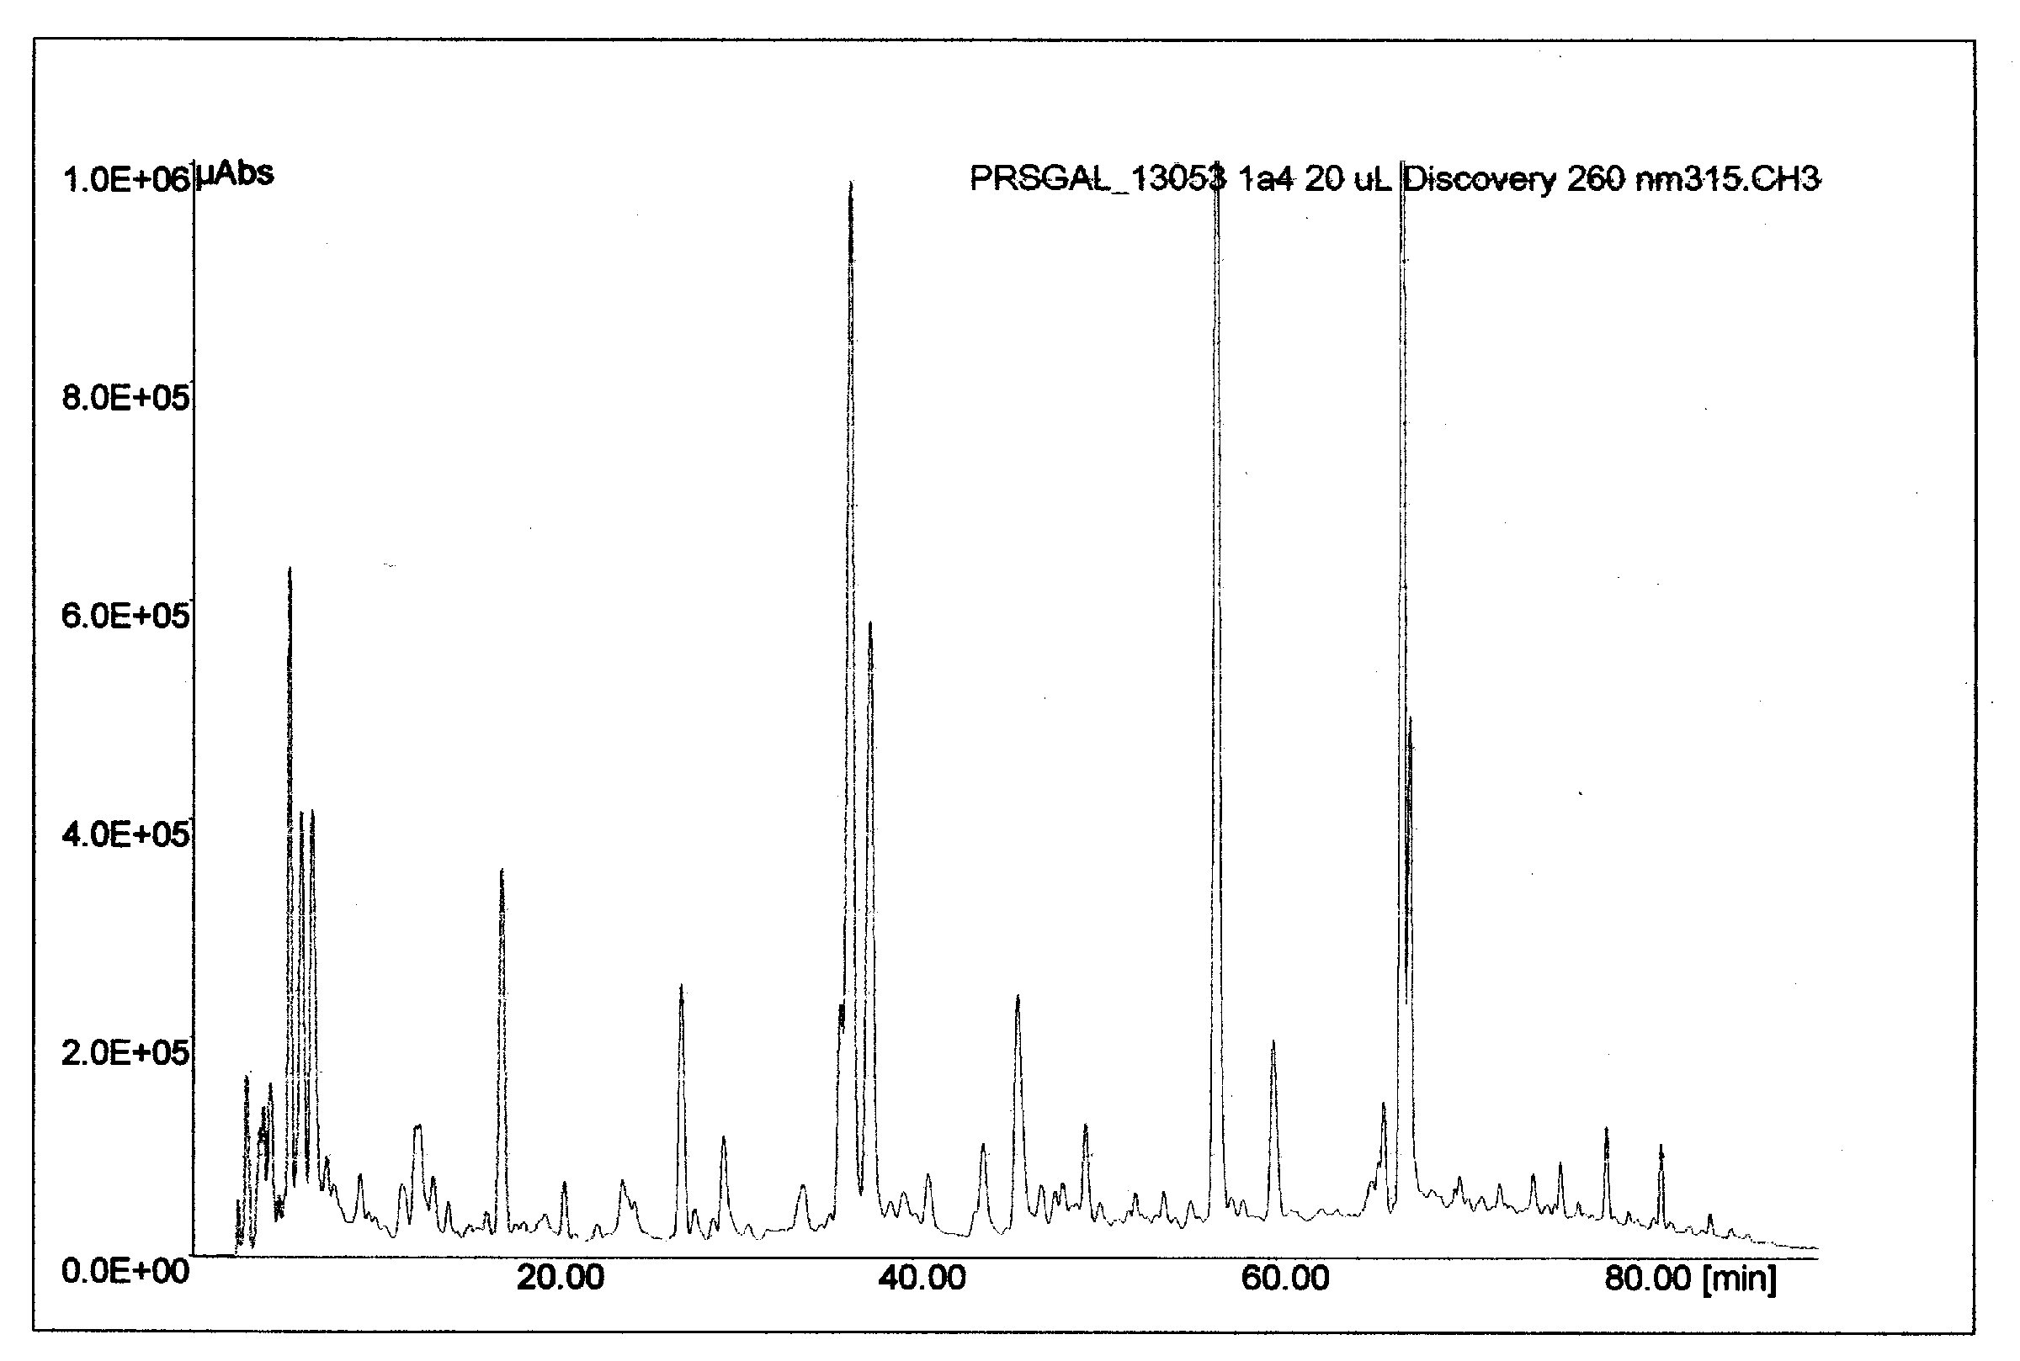
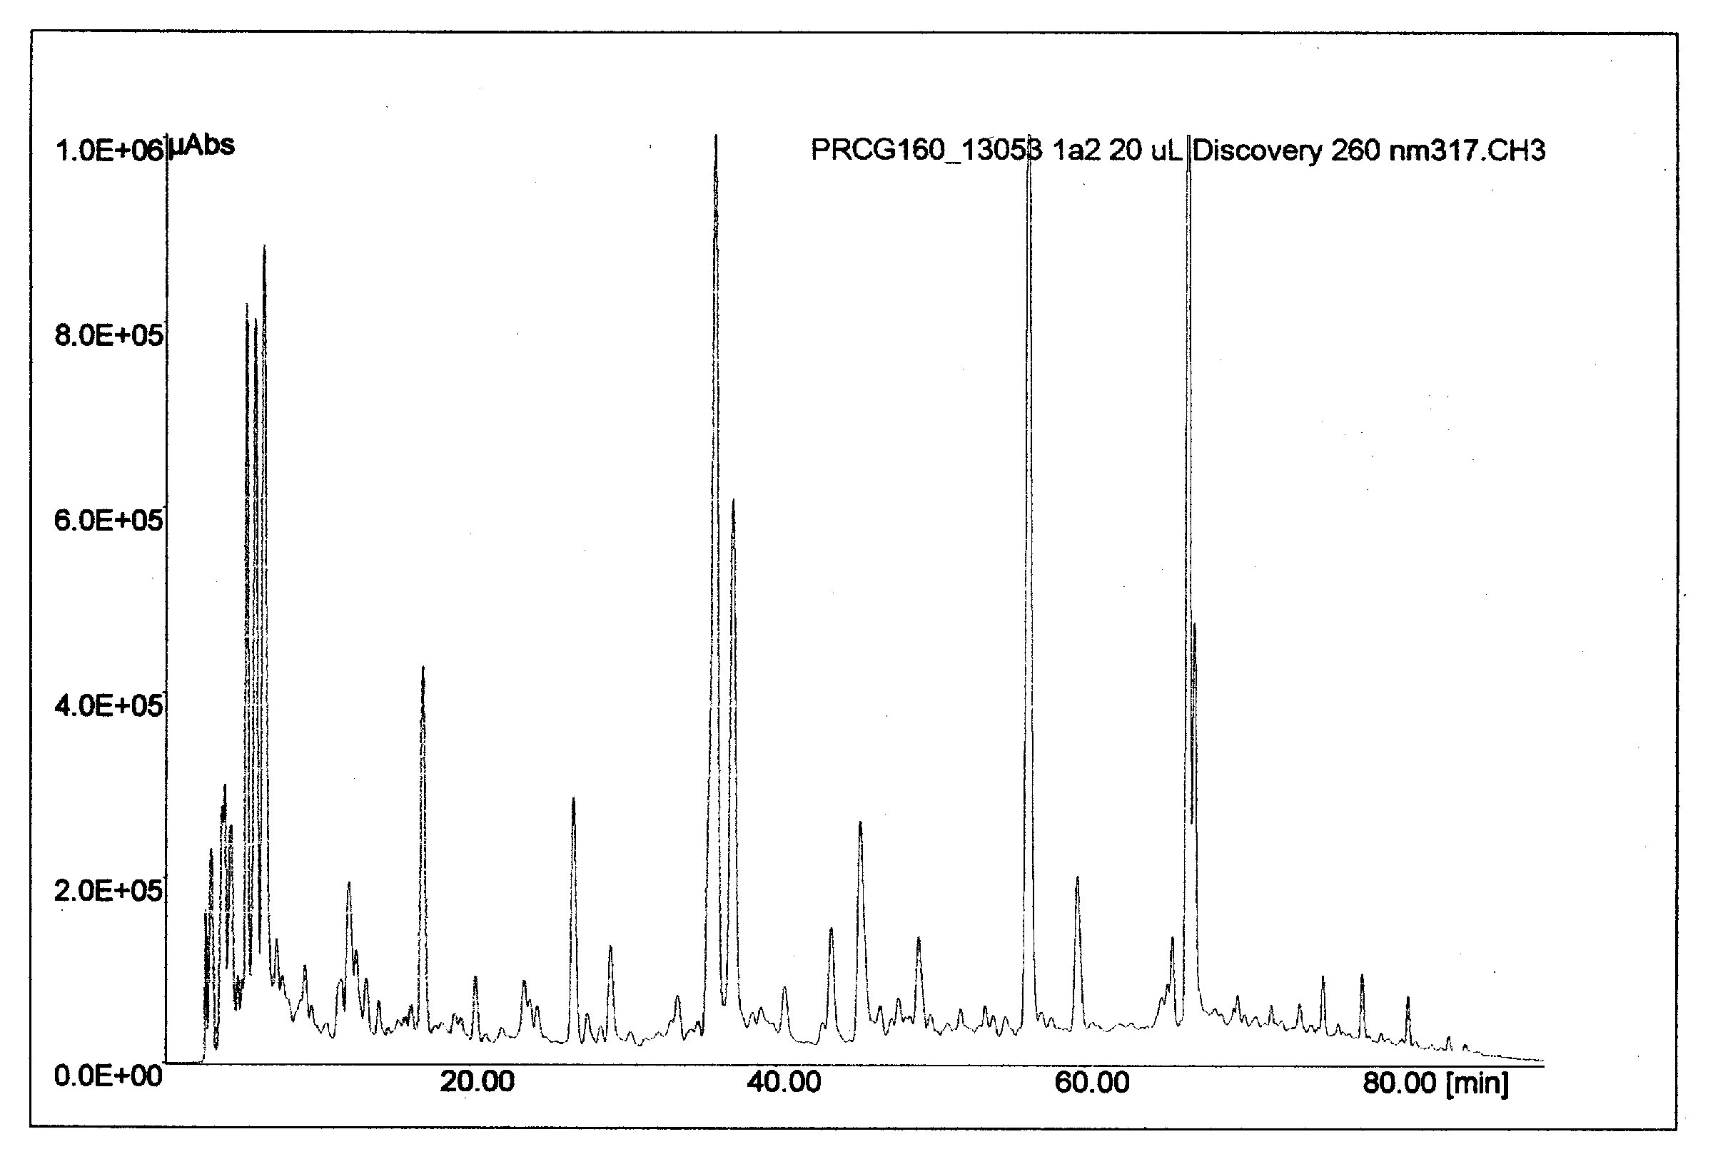
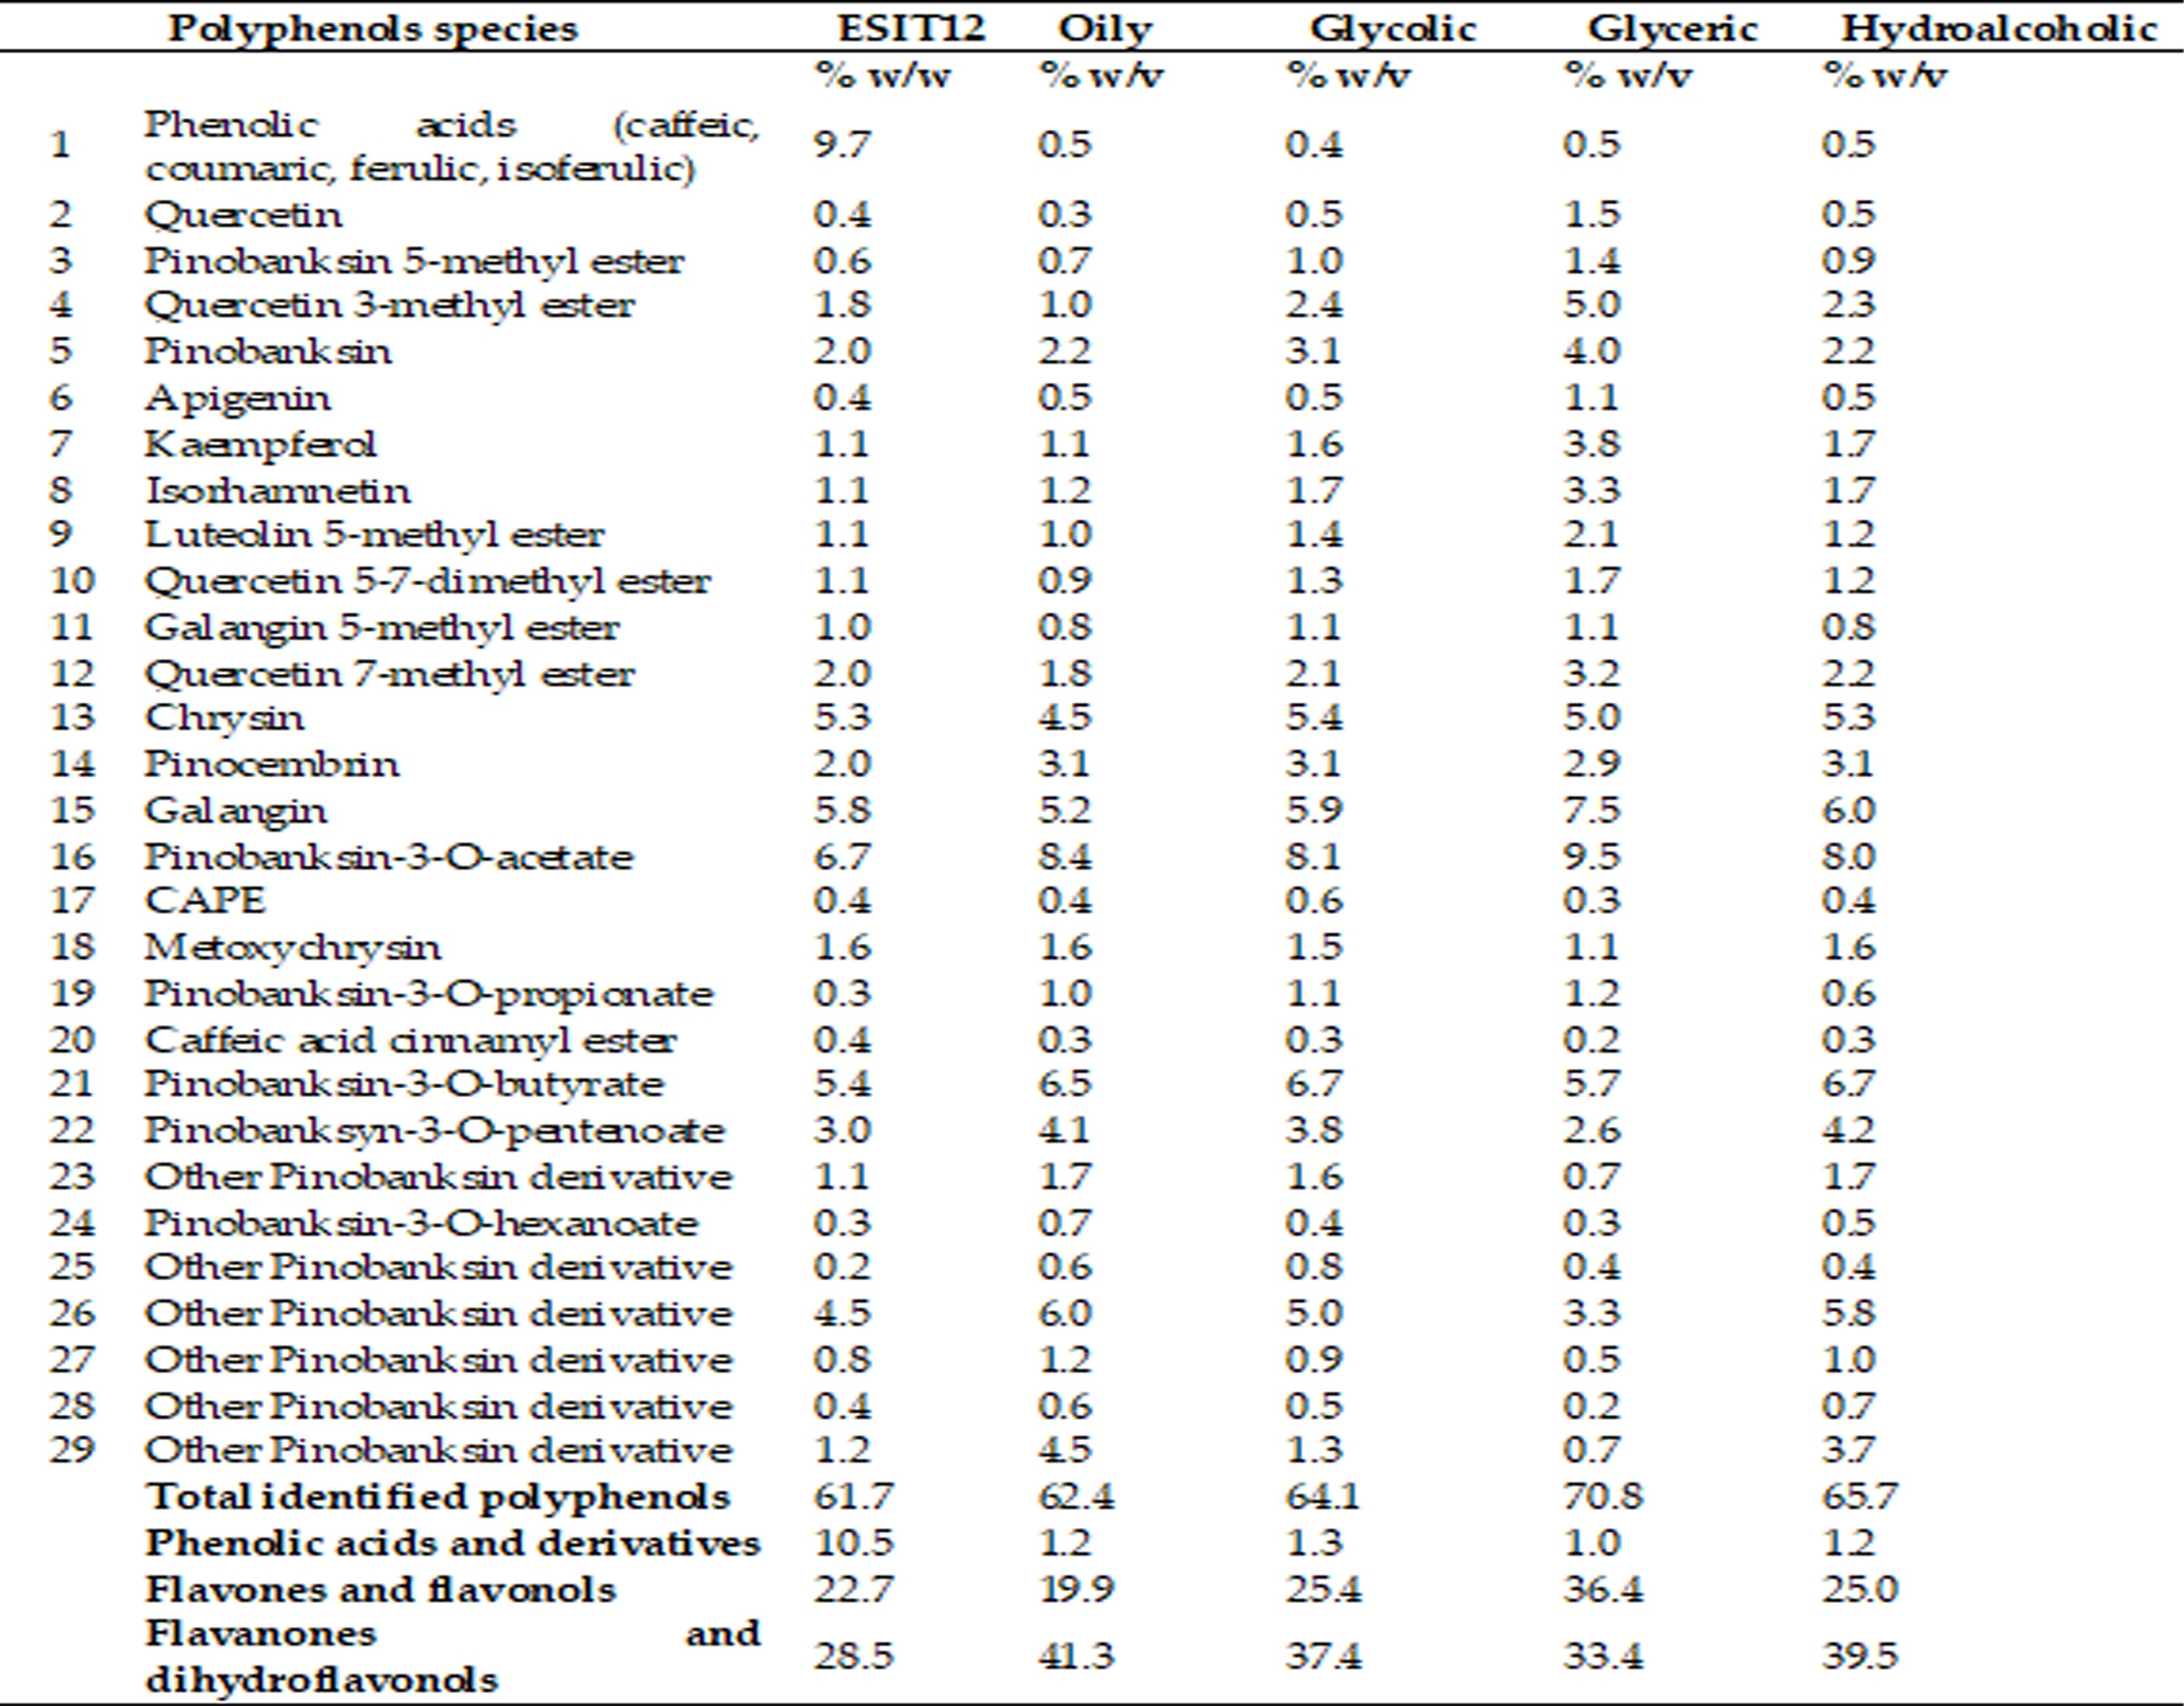
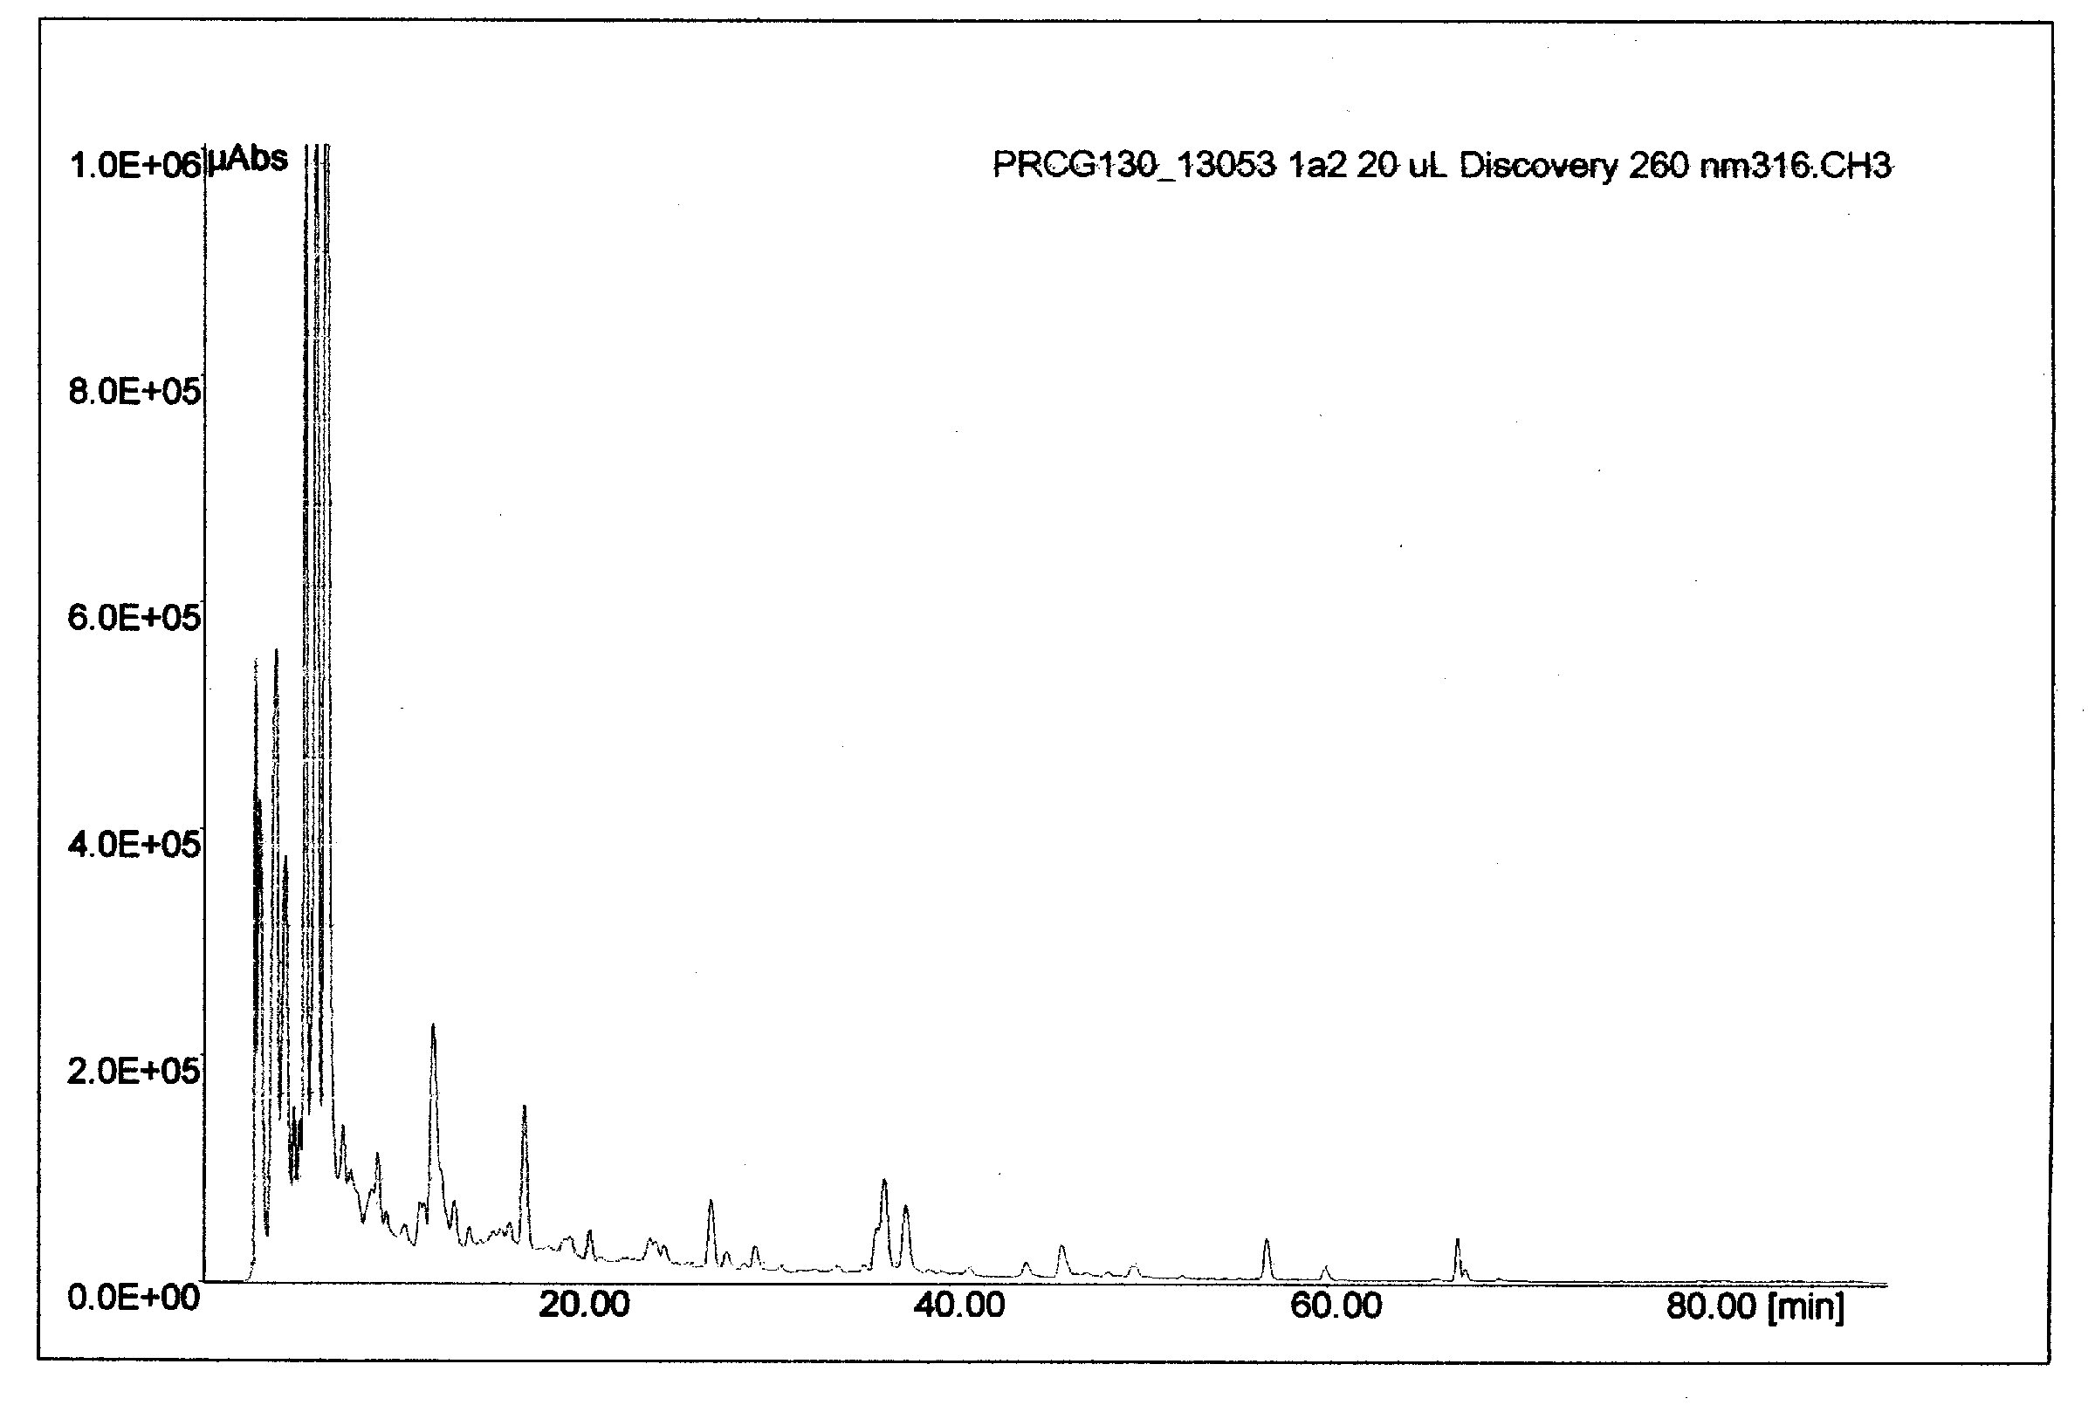
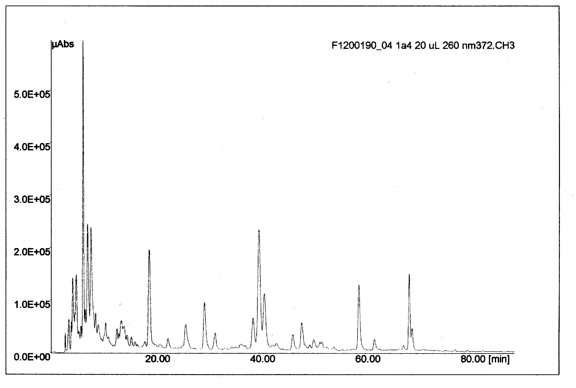
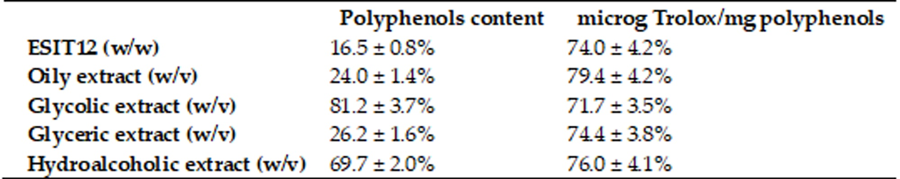
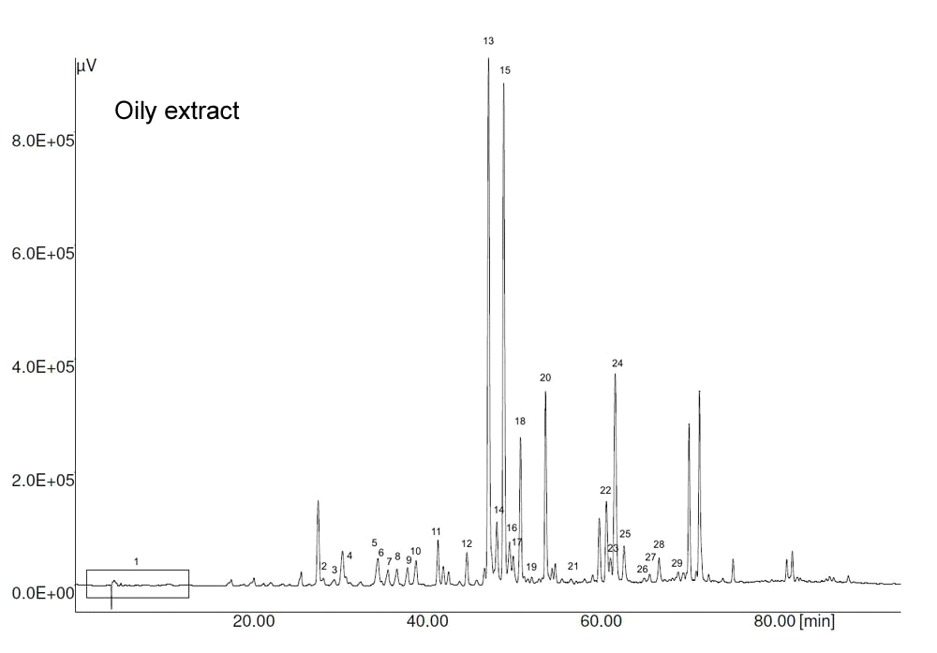
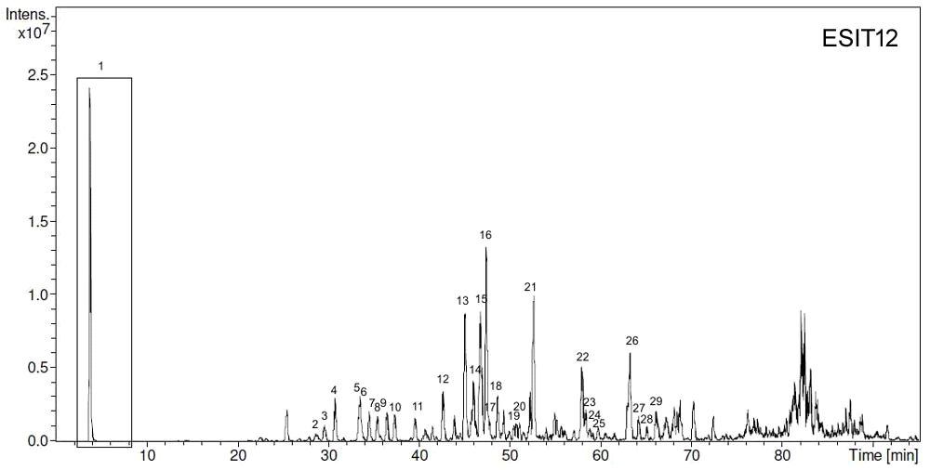
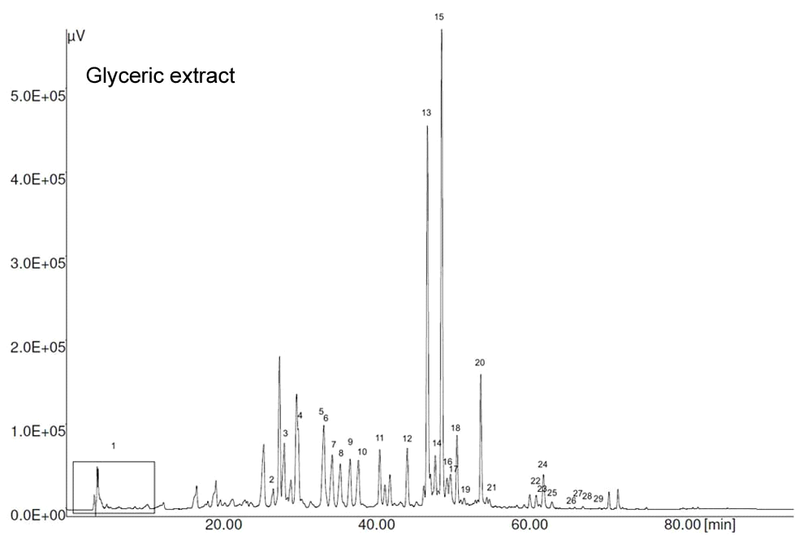
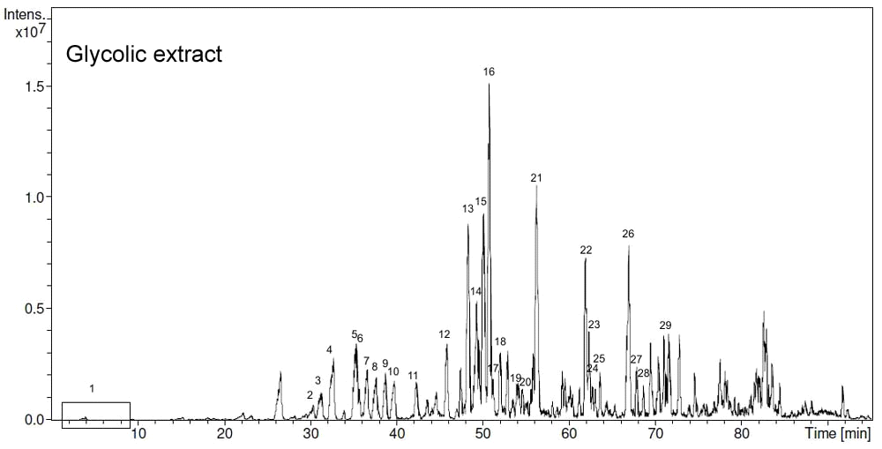
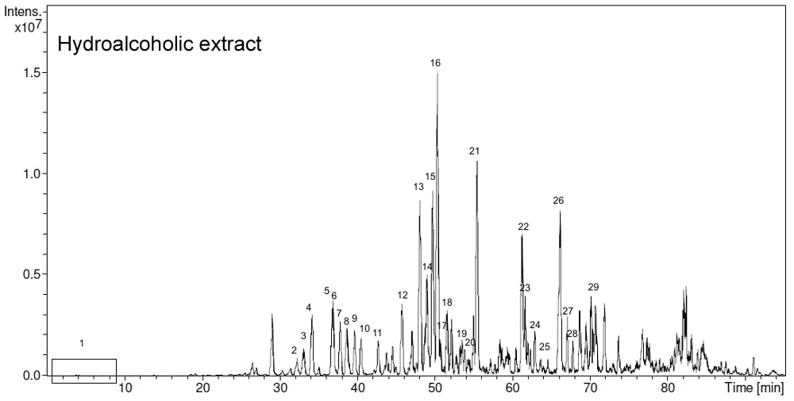
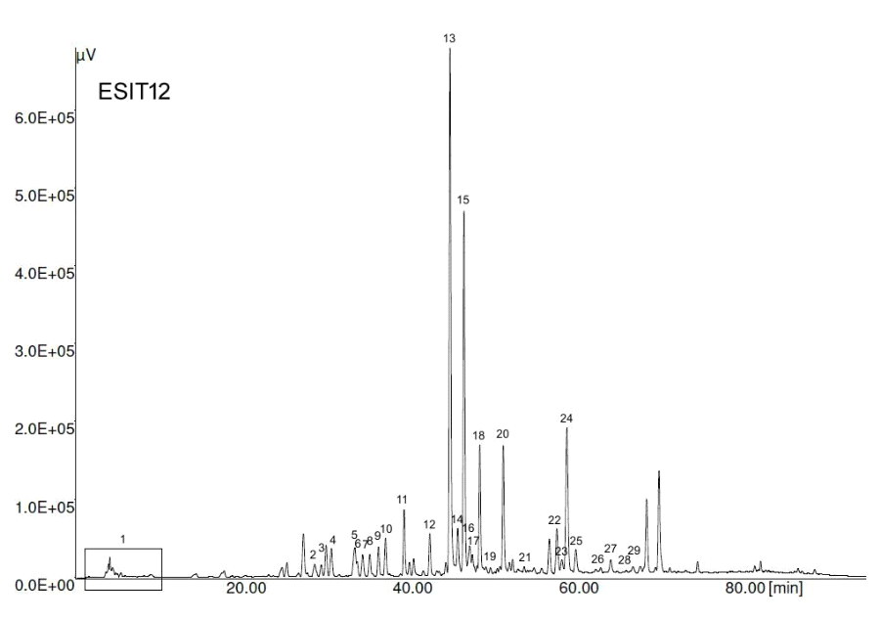
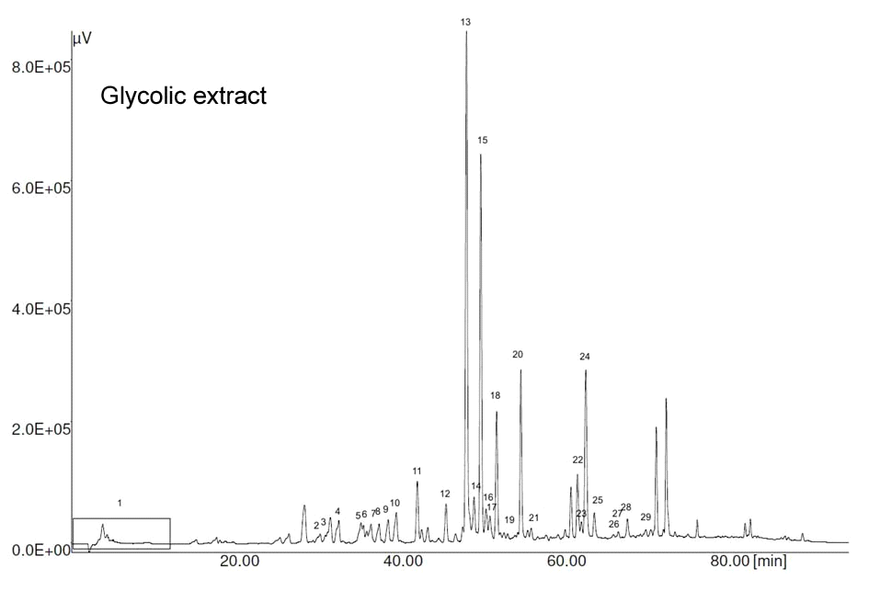
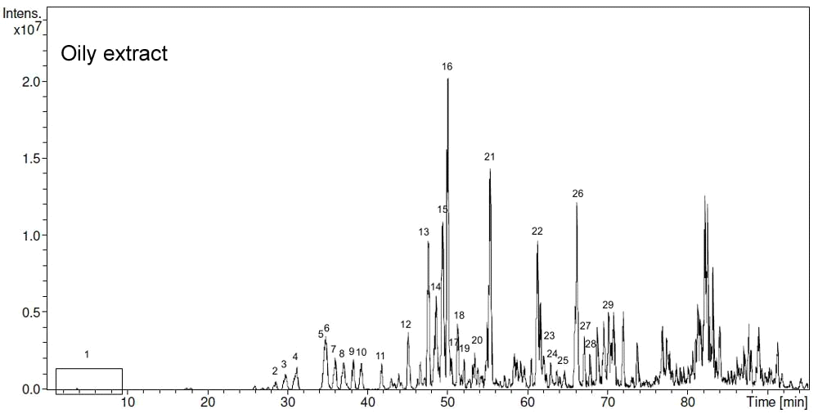
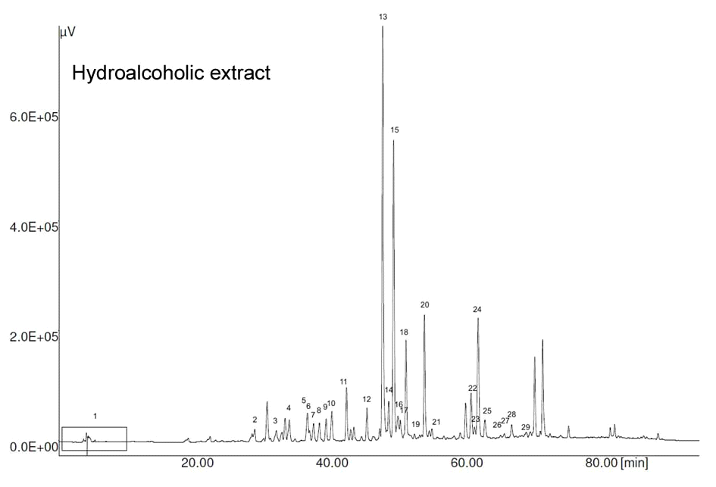
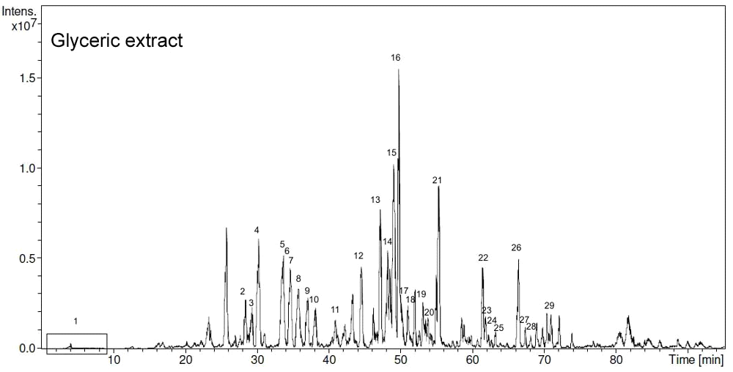
CHEMICAL COMPOSITION AND ANTIOXIDANT ACTIVITY OF PROPOLIS PREPARED IN DIFFERENT FORMS AND IN DIFFERENT SOLVENTS USEFUL FOR FINISHED PRODUCTS*
Nicola Volpi, Fabio Galeotti, Francesca Maccari. Department of Life Sciences, Unimore, Modena, Italy
Alberto Fachini. B Natural, Corbetta (MI), Italy.
State of Art
State of Art
Propolis is a complex material of resinous consistence produced by bees which has a highly variable physical appearance, color and consistence depending on many factors such as geographic origin, types of vegetable sources, time of collection and season of the year. The variations in the chemical composition and consequently in the biological activity of propolis, are associated with its type and geographic origin. However, although propolis is a complex mixture, its biological activities are reported due to the presence of the flavonoids, phenolic acids and ethers mainly obtained from plant-derived substances.
Propolis has been extensively used in folk medicine for many years, and there is substantial evidence to indicate that it has antiseptic, antifungal, antibacterical, antiviral, anti-inflammatory and antioxidant properties. Current applications of propolis include over-the-counter preparations for cold syndrome (upper respiratory tract infections, common cold, flu-like infection) as well as dermatological preparations useful in wound healing, treatment of boils, acne, herpes simplex and genitalis, and neurodermatitis, among other ailments.
Propolis, which is barely soluble in water, cannot be used as raw material and it must be purified by extraction with solvents to remove the inert material and preserve the polyphenolic fraction. These last compounds, flavonoids and phenolic acids, are considered to contribute more to the healing effects than the other propolis constituents.
Due to the very high molecular complex composition of propolis, the different extractive processes utilized and the various solvents available to produce the finished products, the evaluation of the total polyphenols extracted as well as an accurate determination of the single species and of the derived families of compounds with similar chemical properties are necessary to assure products rich in molecular species and still retaining biological properties. Moreover, the different solvents used to solubilize the extracted polyphenols from propolis may have a selective capacity to produce finished products which possess peculiar composition and biological properties.
We evaluated this aspect by dissolving a unique propolis extract in various solvents obtaining different finished products such as hydroalcoholic, glycolic, glyceric and oily as well as a product in the form of powder. The molecular composition of the different preparations was evaluated by HPLC-UV-ESI-MS and the antioxidant activity determined by DPPH anti-oxidant assay.
Analytical Evaluation
Analytical Evaluation
Analytical Evaluation
Results and Discussion
Different products from a unique propolis extract obtained by using various solvents such as hydroalcoholic, glycolic (98% propylene glycol) and glyceric solutions, and oil as well as in powder form, named ESIT12, were prepared. The molecular composition of the different preparations was evaluated by HPLC-UV-ESI-MS and their antioxidant activity determined.
HPLC-UV-ESI-MS and tandem MS analyses of the various propolis preparations in various solvents led to the identification of ~30 compounds in each sample accounting for ~60-70% of the total molecular species. The remaining unidentified part could be mainly represented by the family of triterpenoids and a small fraction of glycosylated derivatives. In fact, triterpenoids are abundant and very common in all vegetable forms and they are generally present in any kind extract.
Propolis is largely used in drinks and foods in form of liquids, effervescient, tablets, pills and others as ingredient in many dietary supplements and nutraceuticals for human nutrition to prevent diseases and improve health. In fact, propolis is used alone or in combination with other natural products not only as a nutraceutical supplement but also as a natural antioxidant in food and related products. Nutraceuticals in particular have emerged in these last years as a major consumer-driven trend capable of preventing diseases, delay aging, and enhance well-being and performance. As it is evident, scientific information on composition, structure and biological activity of nutraceuticals is very important for the advancement of their knowledge. As a consequence, considering the well-known propolis properties and its huge fields of application, there is an increased interest in its activities and composition in the food and nutraceutical products.
All the preparations showed a quite similar polyphenol composition and comparable percentage even if ESIT12 was found to be richer in phenolic acids (caffeic, coumaric, ferulic and isoferulic). Overall, flavones and flavonols ranged from ~20% up to ~36% in the glyceric extract while flavanones and diidroflavonols were between ~28% and ~41%. Besides their quite similar composition, glycolic and hydroalcoholic extracts were found richer in the total polyphenols content. When the antioxidant properties were determined for the four preparations, the activity was similar among them, thus revealing that it is strictly related to the polyphenols content for propolis products whose composition is quite comparable. To date, very few data are available on propolis composition in glyceric and glycolic extracts and information has ever been published on propolis in oil.
In an adjuvant arthritis (AAR) animal m Green alcool 60% odel of polyarthritis (osteoarthritis and rheumatoid arthritis) widely used for preclinical tests, non-animal CS of fermentation origin was capable of significantly reducing the severity of arthritis along with oxidative stress, a consequence of chronic inflammatory processes occurring in AAR. The higher dose of all administered CS (900 mg/kg) was significantly effective in decreasing the arthritic score.
DISCUSSION
In conclusion, we demonstrate that propolis solubilized in different solvents have similar chemical composition when produced from the same raw material, even if a different total polyphenol percentage is obtained, i.e. more or less rich in polyphenol content. A direct consequence of the same composition is a quite similar antioxidant activity when calculated for mg of polyphenols. On the other hand, finished products may have different biological activity if extracted from propolis which has different polyphenolic composition and quality. In fact, the health-promoting capacities of propolis mainly depend on the phenolic compounds and content which represent its biologically active component, as also reported for other kind of extracts.
Finally, this study could be of interest for the food and nutraceutical industries choosing suitable solvents and conditions to solubilize propolis extracts useful to prepare active finished products.
Declaration of conflict of interest: the authors certify that there is no conflict of interest with any financial organization regarding the material discussed in the manuscript.
*PRODUCT PATENTED

