Slide 1
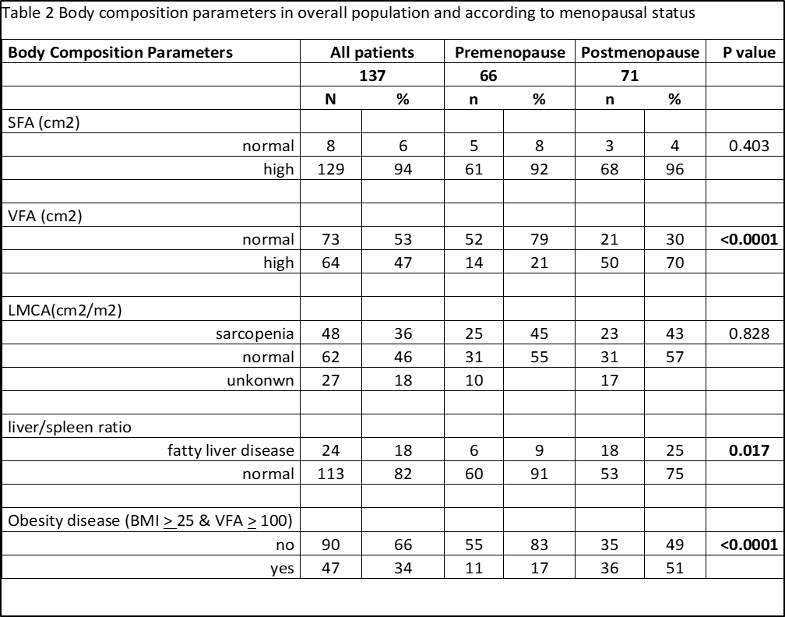
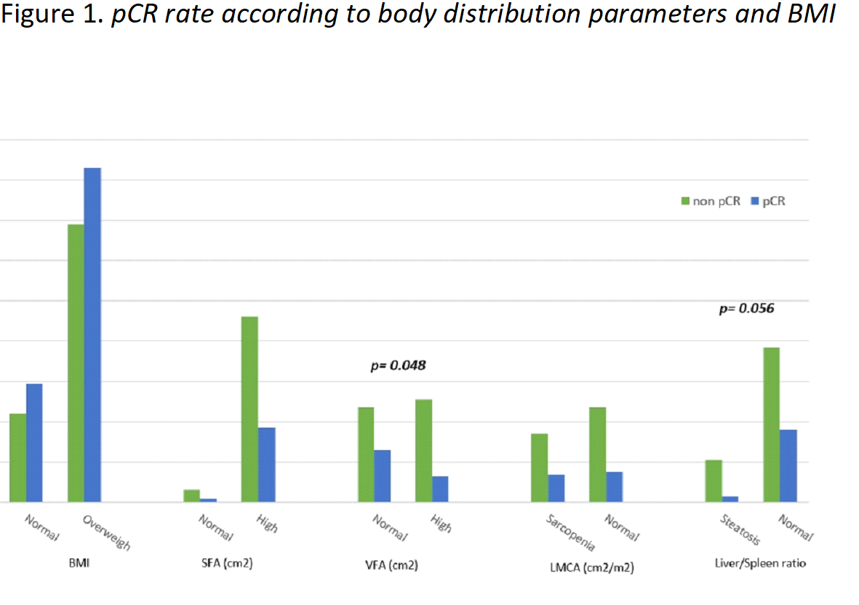
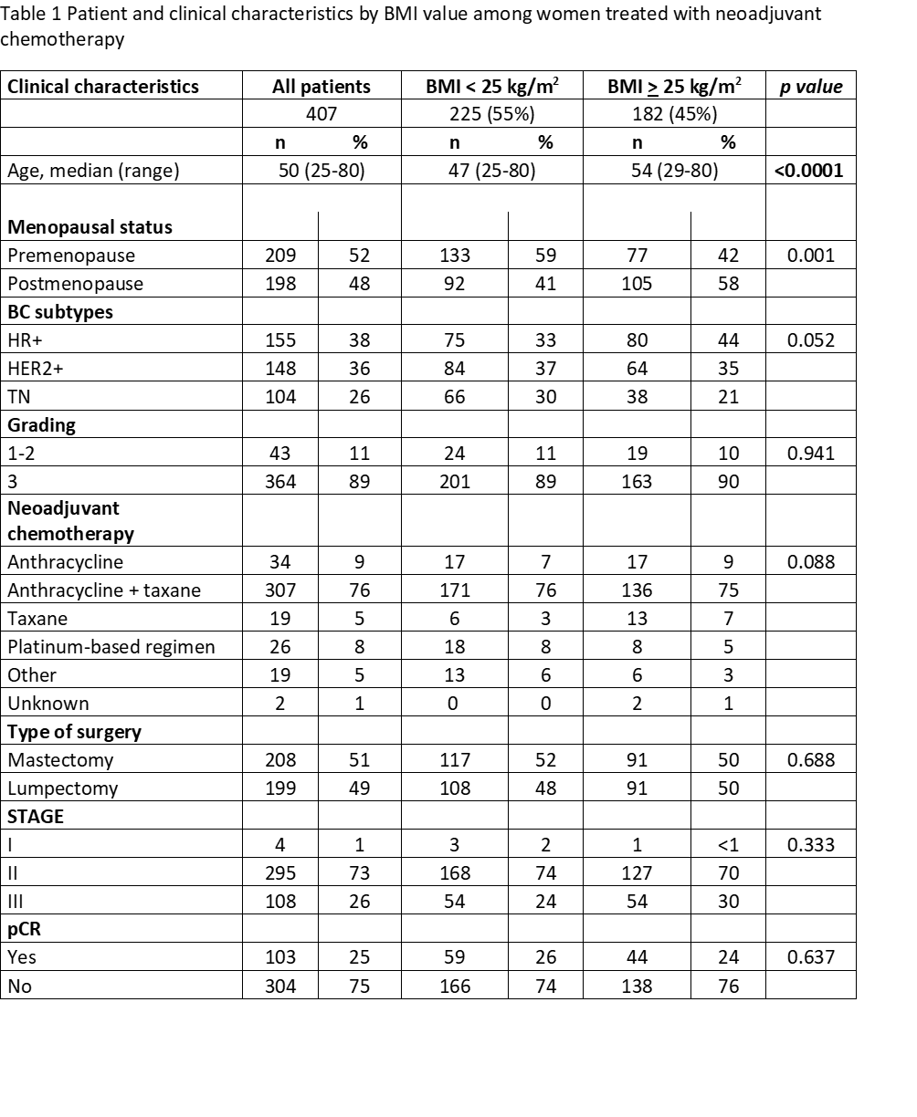
Impact of body composition parameters
on tumor response to neoadjuvant chemotherapy
in operable breast cancer patients.
Palumbo Patrizia, Draisci Stefano, Barbolini Monica, Nasso Cecilia,
Isca Chrystel, Bocconi Alessandro, Balduzzi Sara, Pecchi Annarita,
Galetti Silvia, Torricelli Pietro, Piacentini Federico, Moscetti Luca,
Cascinu Stefano, Omarini Claudia
University Hospital of Modena - Italy
C05
Background
Results
Fat tissue promotes cancer progression by increasing cell proliferation, cell survival and metastatic processes. Adipose tissue determines a dysregulation of several metabolic pathways by a continuous crosstalk between fat tissue and cancer cells. Moreover, influence of adipose tissue on cancer development depend on the type of fat too
BMI cannot account for differences in fat distribution and cannot distinguish between adipose tissue and muscles
Computed tomography (CT) imaging can be a useful tool for a directly measure of body fat distribution distinguishing among visceral, subcutaneous, internal fat tissue (mostly in the liver) and skeletal muscles mass.
407 patients were included in the study; 137 of them had pre-treatment CT scan imagine available for BCPs analysis
55% of the women had BMI < 25 versus 45% with BMI >25
Overweight was significantly associated with postmenopausal status, older age and hormonal receptor positive BC (Table 1)
Menopausal status was associated with higher VFA, presence of fatty liver disease and obesity disease compared to pre-menopausal one (Table 2).
Aim
Our goal was to examine associations between measure of body composition parameters (BCPs), considering adiposity and sarcopenia, and response to neoadjuvant chemotherapy in patients treated for operable BC.
Methods
Patients treated with neoadjuvant chemotherapy for early BC at the Modena Cancer Center from 2005 to 2017 we collected.
According to BMI score, patients were categorized in two main classes: normal weight (BMI < 25) and overweight (BMI ≥ 25) (Table 1)
Using Advance workstation (General Electric), software ADW server 3.2 or 4.7. we calculated body composition parameters (BCPs) from pre-treated CT scan images. BCPs considered are: subcutaneous fat area (SFA, cm²), visceral fat area (VFA, cm²), lumbar muscle cross-sectional area (LMCA, m²) and liver steatosis (L/S ratio)
BMI score and BCPs value were correlated with pathological complete response (pCR) and survival outcomes. All analyses were performed using STATA 14 (StataCorp. 2015. Stata Statistical Software: Release 14. College Station, TX: StataCorp LP).
No association between BMI classes and pCR was detected. High VFA and liver steatosis were negative predictive factors for pCR (pCR rate: 35% normal VFA vs 20% high VFA, no steatosis 32% vs steatosis 13%; p<0.05) ( Figure 1)
Neither BMI classes nor BCPs significantly influenced overall survival and relapse free survival.
Conclusions
The evaluation of BCPs is the best way to assess the real body composition
Menopausal status is associated with higher VFA, presence of fatty liver disease and obesity disease
Visceral adiposity as well as liver steatosis were negative predictive factors for pCR in BC patients treated with neoadijuvant chemotherapy .
References
Sun, L., et al., Body mass index and prognosis of breast cancer: An analysis by menstruation status when breast cancer diagnosis. Medicine (Baltimore), 2018. 97(26): p. e11220.
Van Kruijsdijk, R.C., E. van der Wall, and F.L. Visseren, Obesity and cancer: the role of dysfunctional adipose tissue. Cancer Epidemiol Biomarkers Prev, 2009. 18(10): p. 2569-78.
Gourd, E., Sarcopenia and adiposity linked to overall survival. Lancet Oncol, 2018. 19(5): p. e239.
Caan, B.J., et al., Association of Muscle and Adiposity Measured by Computed Tomography With Survival in Patients With Nonmetastatic Breast Cancer. JAMA Oncol, 2018. 4(6): p. 798-804.
Iwase, T., et al., Impact of body fat distribution on neoadjuvant chemotherapy outcomes in advanced breast cancer patients. Cancer Med, 2016. 5(1): p. 41-8.
For information e-mail to claudia.omarini@gmail.com

