Slide 1

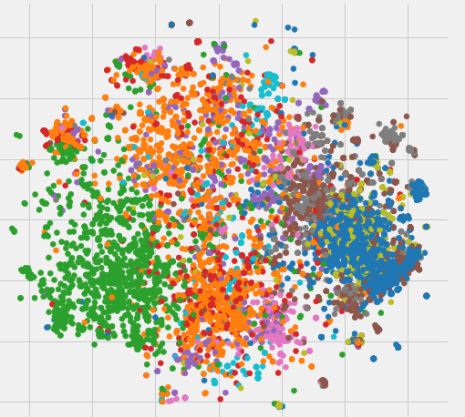
Using Word Embeddings for Italian Crime News Categorization
Giovanni Bonisoli, Federica Rollo, Laura Po
Enzo Ferrari Engineering Department
University of Modena and Reggio Emilia, Italy
federica.rollo@unimore.it

Slide 2

Crime categorization
Understanding the crime category a text is related to and associate the text to the appropriate category
THEFT
DRUG DEALING
AGGRESSION
ATTACK
MURDER
ROBBERY
KIDNAPPING
FRAUD

Slide 3
Motivation
The main goal of crime categorization is to enable classification of crime events for statistical purposes. This is the first step to perform Crime Analysis, i.e. systematic analysis for identifying and analyzing patterns and trends in crime.
Crime Analysis allows:
to detect critical areas
to identify the types of crime being committed
to understand crime patterns and victimization
to effectively guide police action

Slide 4
Workflow
Background:
No up-to-date crime datasets available as open data
In Italy, the National Institute of Statistics (ISTAT) publishes only reports with the aggregated number of crimes for each province in one year
Alternative sources:
Newspapers
Issues to face:
Information is in natural language, crime category is not always specified by the newspaper
Goals:
Generating semi real-time statistics for crime analysis
Performing crime-specific analysis of the news articles (e.g., extracting the stolen object in a theft)

Slide 5
Italian crime news dataset
15,361 news articles from 2 Italian newspapers
from 2011 to now (approximately 9 years)
13 crime categories: theft, robbery, murder, sexual violence, mistreatment, aggression, illegal sale, drug dealing, scam, fraud, money laundering, evasion, and kidnapping
Dataset content:
URL of the web page containing the news article,
title of the news article, sub-title, text,
place where the crime occurred,
date of publication and date of crime event,
crime category
Unbalanced dataset on the crime category

Slide 6
The approach
Computing the news articles representation using WORD EMBEDDINGS
SUPERVISED TEXT CATEGORIZATION
UNSUPERVISED TEXT CATEGORIZATION
Training a SUPERVISED MODEL with the news articles representation and the associated labels (crime category)
Providing the news articles representation as input to an UNSUPERVISED MODEL (clustering) and studying the clusters

Slide 7
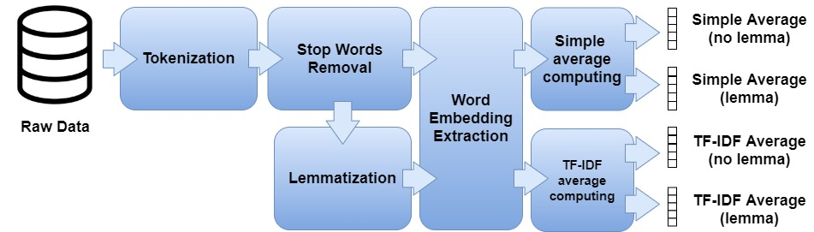
News articles representation
4 types of news articles representation
TOKENIZATION
STOPWORDS REMOVAL
WORD EMBEDDING EXTRACTION
SIMPLE AVERAGE COMPUTING
TF-IDF WEIGHTED AVERAGE COMPUTING
LEMMATIZATION

Slide 8
Word Embedding extraction
3 Word2Vec models:
M1: an existing Italian model, pre-trained on a 2.6 GB dataset (a dump of Wikipedia, Italian Google News and anonymized chats of the customer care chatbot Laila).
M2: a Skip-Gram model trained from scratch on our Italian crime news dataset for 30 epochs
M3: a Skip-Gram model which has been trained on our Italian crime news dataset for 5 epochs, starting from the embeddings of M1

Slide 9
News articles representation
M1
M2
M3
12 different representations for each news article

Slide 10
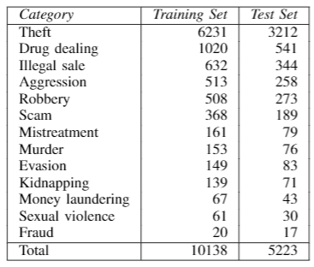
Supervised Text Categorization
65% training set, 35% test set
15 supervised algorithms:
SGD (L2 norm, Hinge loss),
SGD (L1 norm, Perceptron),
SVC (RBF kernel, C=1.0, gamma=‘scale’),
Linear SVC (C=1.0),
GaussianNB,
BernoulliNB,
K-nearest-neighbour (k=1),
K-nearest-neighbour (k=3),
K-nearest-neighbour (k=5),
Decision Tree,
Random Forest Classifier (n=100),
Adaboost (DecisionTree),
Bagging (DecisionTree),
Bagging (KNN n=5),
XGBboost

Slide 11
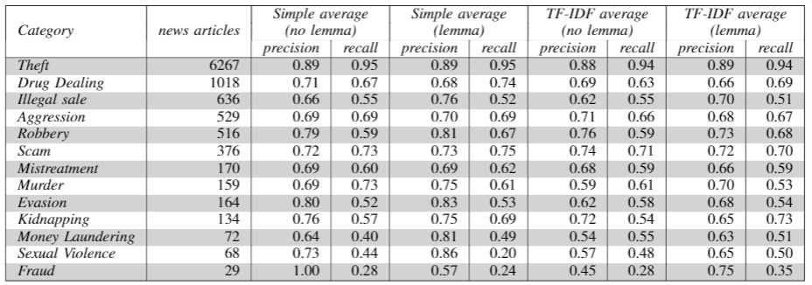
Supervised Text Categorization
The best results have been obtained by the algorithm “Linear SVC” with the embeddings of M3

Slide 12
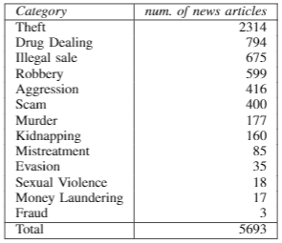
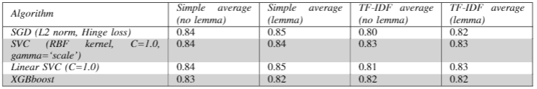
Supervised Text Categorization
5,693 news articles
High values of accuracy:

Slide 13
Unsupervised Text Categorization
Grouping news articles in such a way that news articles in the same group (called cluster) are more similar each other than those in the other groups.
Synthetic Minority Oversampling Technique (SMOTE)
Model M3
4 unsupervised algorithms:
K-means
Mini Batch K-means
Agglomerative Clustering
Spectral Clustering
13 clusters

Slide 14
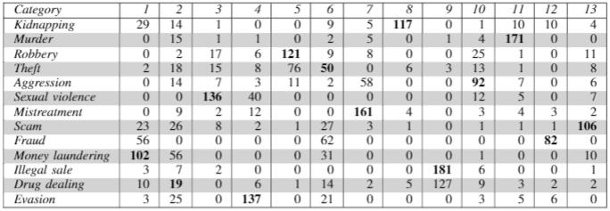
Unsupervised Text Categorization
The best result is given by the Spectral Clustering using the news article representations generated with the simple mean of the word embeddings without lemmatization.
Accuracy 0.93

Slide 15
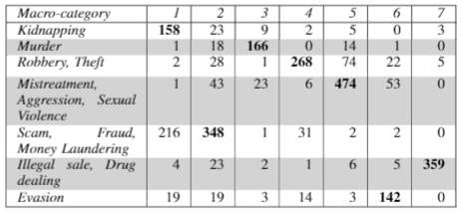
Unsupervised Text Categorization
7 MACRO-CATEGORIES:
Kidnapping
Murder
Robbery, Theft
Mistreatment, Aggression, Sexual Violence
Scam, Fraud, Money Laundering
Illegal Sale, Drug Dealing
Evasion
The best result is given by the Agglomerative Clustering using the news article representations generated by the simple average with lemmatization.
Accuracy 0.92

Slide 16
Conclusion
Supervised and unsupervised text categorization on an Italian crime news dataset
Word2Vec model
Best results:
Linear SVC (supervised text categorization) – accuracy 0.80-0.85
Spectral and Agglomerative Clustering (unsupervised text categorization) – accuracy 0.93
Unsolved issues:
Imbalance dataset in supervised text categorization
Inaccurate annotation extracted from the newspapers

Slide 17
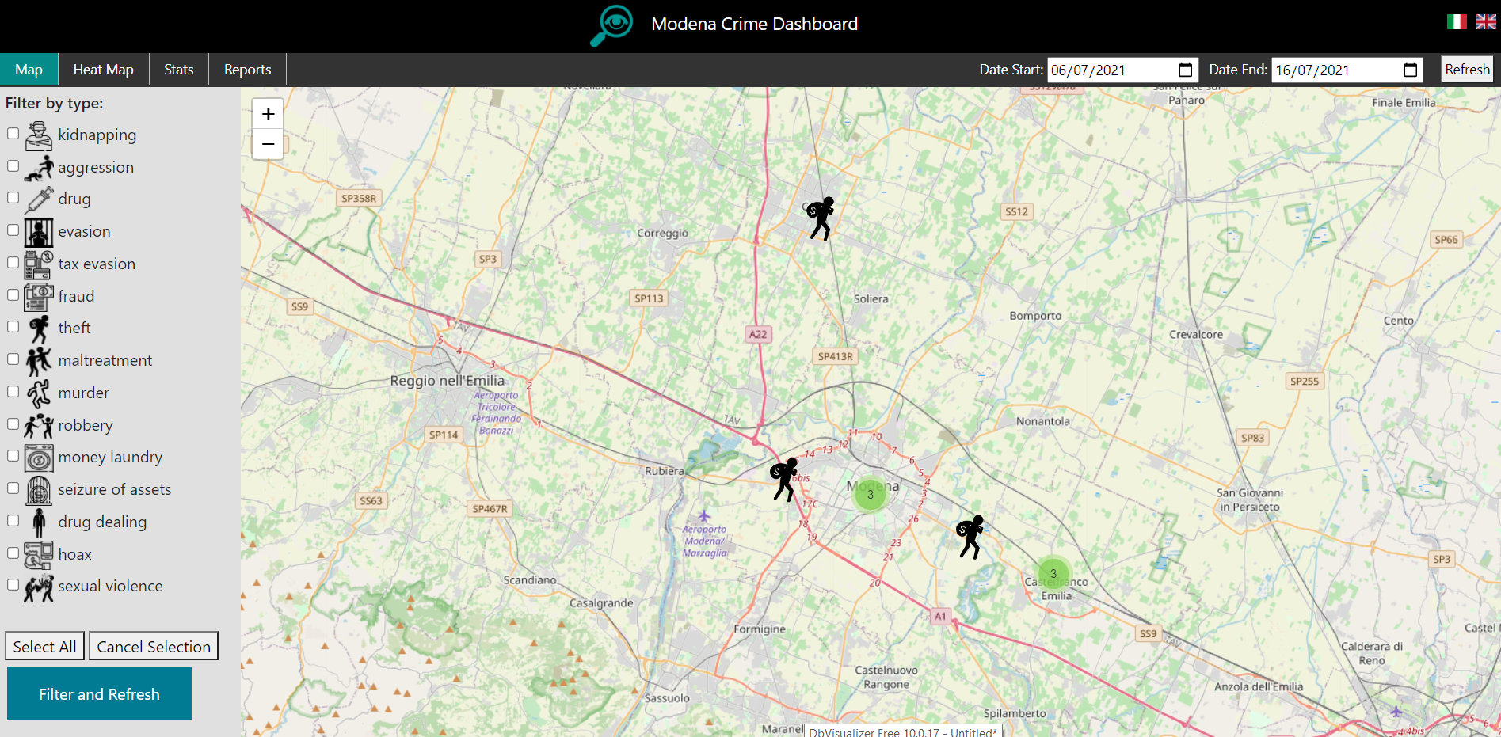
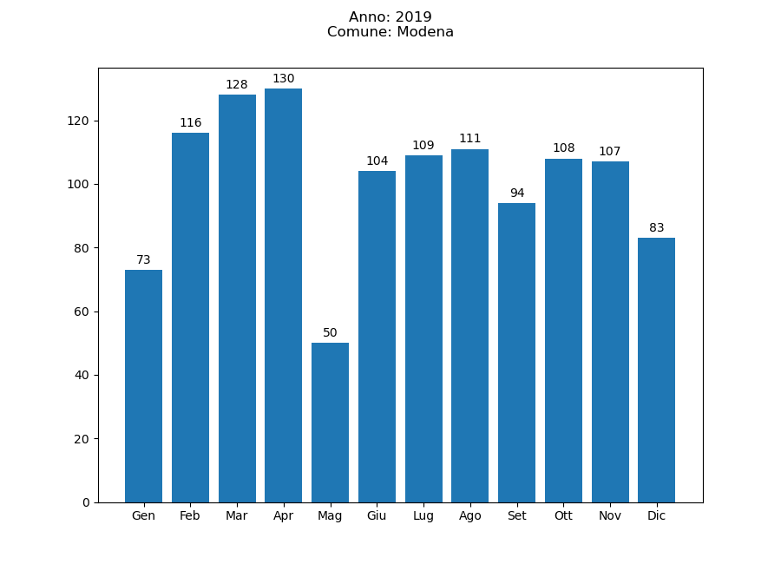
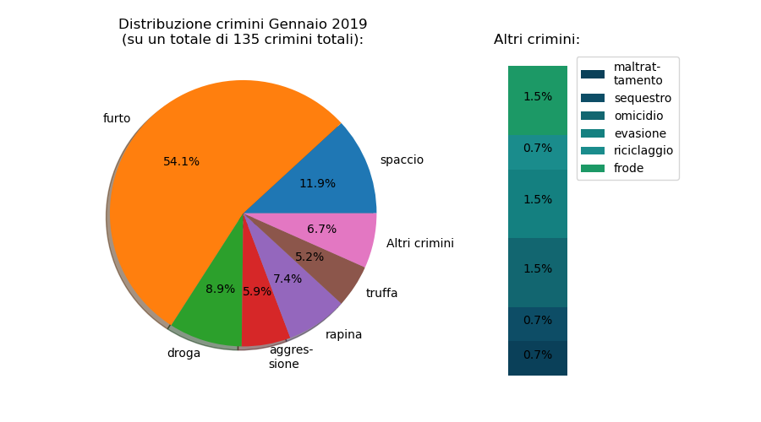
Crime Analysis project
https://dbgroup.ing.unimore.it/modenacrime
Year 2019, Modena
MODENA, ITALY
Crime rates January 2019 (total number of crimes: 135)

Slide 18
Future Work
Exploiting active learning to improve the categorization provided by the newspapers
Testing other models (e.g. FastText, Glove) to obtain word embeddings and comparing the results
Enhancing the categorization identifying more detailed categories (e.g. apartment theft, car theft)
5W1H extraction - exploiting the category identified by our algorithms to extract category-specific information (e.g. which is the stolen object in a theft, what weapon was used during a robbery)
Generating a knowledge graph with the extracted information

Slide 19

Thank you
https://dbgroup.ing.unimore.it/modenacrime
Giovanni Bonisoli, Federica Rollo, Laura Po
Enzo Ferrari Engineering Department
University of Modena and Reggio Emilia, Italy
federica.rollo@unimore.it

